Slide 1
RACCA
Charting the Course for Tomorrow’s Aviation Leaders; UND’s Student Career Aspirations Study

Slide 2
Agenda
Pilot certification trends though 2024
Career Aspirations Survey Results

Slide 3
Annual Student Certificates Issued
(FAA Civil Airmen Statistics Table 17)
Notes:
Declined by 8150 or 11.7%

Slide 4
Annual Private Certificates Issued
(FAA Civil Airmen Statistics Table 17)
Notes:
Declined by 982 or 3.1%

Slide 5
Annual Commercial Certificates Issued
(FAA Civil Airmen Statistics Table 17)
Notes:
Declined by 230 or 1.2%

Slide 6
Annual ATP Certificates Issued
(FAA Civil Airmen Statistics Table 17)
Notes:
Declined 1705 or 15.2%

Slide 7
Annual CFI Certificates Issued
(FAA Civil Airmen Statistics Table 17)
Notes:
+107 or .09%

Slide 8
Total vs. Active CFI’s (at least I recommendation) 2021/2022/2023/2024
Notes:
Active CFIs continues to grow a few hundred per year.

Slide 9
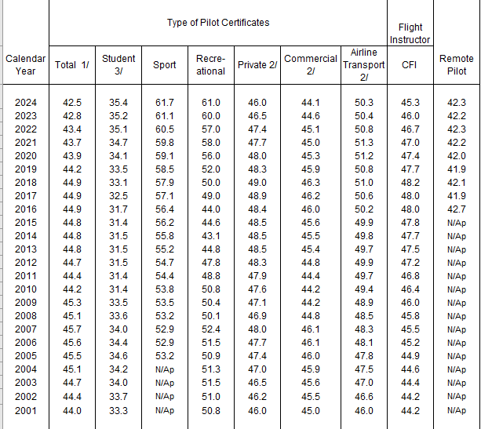
Pilot Population (FAA Civil Airmen Statistics Table 13)
Pilot populations finally see some decreasing ages in certain categories
Notes:
Total age continues to decrease, young populations finally impacting average age

Slide 10
US vs. Non-US FAA Certificated Pilots as of December 31, 2021

Slide 11
US vs. Non-US FAA Certificated Pilots as of December 31, 2024

Slide 12
SEPTEMBER 2025 Career Aspirations Survey of UND Aviation Students
Notes:
Assumed that there would be a downturn in professional flying due to the hiring pause of 2024/2025.

Slide 13
Survey Participants
Demographics (n=253)
Notes:
A lot more Freshmen responded this time and less seniors and recent grads (CFIs).

Slide 14
Which of the following fits your long-term career goal when you began your flight training?
Notes:
Updated 9/25/25. Not all students are decided on their career choice and we allowed them to rate each career on how well it fit with their long-term career goal. Percentages of total are as follows: does not fit, somewhat fits, fits completely
Airline Pilot (Major Airlines): 72% (down 1% from last time)
Air Cargo Pilot (Legacy): 30%
Corporate Pilot: 30% (up 16% from last time)
Fractional Pilot: 15% (up 12% from last time)
Military Pilot: 11% (down 2% from last time)
Spray Pilot: 9.5% (new since last time)
Professional CFI: 9.5% (down 3.5% from last time)

Slide 15
Rate your perception of current employment opportunities
Notes:
The higher the value, the better the perception of the career opportunities (4 = excellent, 0 = poor) Five-point answer scale

Slide 16
Indicate your interest in the following to gain the experience required to reach your long-term career goal.
Notes:
Updated 9/25/25. Percentage breakdown: Not interested, some what interested, very interested
Regional Airline Pilot: 73%
Ultra Low Cost Pilot: 37%
CFI: 41%
Air Cargo Pilot: 30%
Corporate Pilot: 36%
Fractional Pilot: 23%
Spray Pilot: 17%
Military Pilot: 16%

Slide 17
If your career aspirations have changed since you began your flight training, why have career goals changed?
Very few indicated their original career choice has changed.
Those that did said
  Flight training too difficult
  Awareness of other career opportunities
  FAA medical issues
  Slowing airline hiring
  Costs

Slide 18
Career Goal Conclusions
There’s been a marked increase in number of students considering corporate/fractional pilot careers.
Cargo careers continue to be slightly higher than previous surveys
Students become far more aware of the varying career opportunities the longer they spend at UND
Changes from career plan are a result of: medical, cost, decrease demand for airline pilots, flight training challenges

Slide 19
I would choose to work for a particular company because of:
Notes:
Updated 9/25/25 disagree, neutral, agree
Percentages (all are down significantly since last survey – students more discerning?) but the order or ranking is similar to 2017
Hourly Pay: 83%
Pay Incentives: 76%
Guaranteed Flow: 74%
Crew Base Locations: 73.5%
Good Safety Record: 71%
Pathway U to Major: 70%
Recommendation of Friend: 55%
Captain Upgrade Time: 60%
Active Recruitment: 51%
Pilot Union Contract: 44.5%
Type of Aircraft: 43%

Slide 20
Indicate your level of agreement with following statements regarding regional cargo carriers
Notes:
Updated 9/25/25.
Percentages disagree, neutral, agree
Improve Skills: 61%
Improve Marketability: 61%
Prefer PIC: 59%
Anything But CFI: 51.5% (dropped more than others)
Easiest Path: 47.5%
Cargo Improve > CFI: 28%
CFI Safer: 8%

Slide 21
What is the single most effective action that a company can take to recruit you as a pilot?
Engagement and communications (campus visits, honesty, mentorship) (60)
Guaranteed track/pathway program (34)
Pay and benefits(32)
Company reputation –safety, retention, positive culture (20)
Hire me (20)

Slide 22
Overall Conclusions
Career aspirations have not changed much compared to earlier surveys
Large numbers of students aspire to be a an airline pilot
Interest in corporate and fractional career choices have increased.
Making direct/human connection with students while in school very important in recruiting
Pathway programs are still valued by students in deciding what company to work for.

Slide 23
Thank you
Kent Lovelace
kent.lovelace@und.edu
Shayne Daku
shayne.daku@und.edu

